Slide 1
BANCO SANTANDER Corporate & Investment Banking SCIB Agentics for Finance FMIS & SANART

Slide 2

Index
FMIS
SANART
Agentic Architecture
RPA Solution

Slide 3

FMIS
01

Slide 4


FMIS — Central system for financial calculation and reporting.
FMIS is the central system for financial calculation and reporting, taking the daily balance sheet as its main base. From this, the daily TTI is calculated, differentiated by product type within the CIB perimeter, covering both Branches and GBP
MAIN FUNCTIONALITY
ACCOUNTING SOURCES AND INTEGRATIONS
The system generates daily P&L balance information and average balance data, which are reported in the accounting books used by the Management Control and Finance areas. FMIS integrates multiple data sources, with BDH being the main operational source feeding intercompany information. Through its own iterative logic, it determines the CIB product and the associated business area.
Off-ledger information is the main source for the GBP perimeter, while the Equation accounting files feed the Branches perimeter, with the objective of migrating both sources to the Accounting Data Hub. The system ingests other types of complementary information such as interest rate curves, exchange rates, manual adjustments, and ESG data related to intercompany operations, thereby consolidating all the information required for the organization’s end-to-end financial management.
Data input
FMIS Internal Processes
Data Output
BBDD
LANDING LAYER
ERROR CATALOGING
ERROR CORRECTION
COMMON DATA
REPORTING
Data Ingestion Sources:
API Calls (structural data, exchange rates, STRATUS customer catalog)
Output Manager (queries between systems to BHD, which stores them on the server)
M1 FMIS Files (accounting and off-ledger data), sent directly to the FMIS server
Emails (manual uploads
The most critical errors are detected in the Landing layer and can propagate to Common Data.
Errors identified by users are recorded in the error catalog table according to their specific cases (in the OAS Oracle visualization tool), including variations in transaction volumes. Currently, errors are managed through ServiceNow tickets with the relevant systems or via email, requiring error remediation.
With the information normalized in the Common Data layers, it passes through a decision tree via an ETL process, after which each transaction is assigned the methodology, it should follow for TTI calculation
Output of information with the TTI calculation, which is recorded in the business books and consumed by downstream systems.

Slide 5



The implementation of agents is primarily planned for the Common data layers where the TTIs are calculated. The value proposition includes positioning the agent as a monitoring tool for TTI calculations and implementing a chatbot capable of retrieving information from the decision tree using natural language.
FMIS — Agent Implementation.
Data Input
FMIS Internal Processes
Data Output
Information is received from various data sources such as BDH, Accounting Data Hub, Stratus, Asset Control, and MISCO.
It passes through a decision tree via an ETL process, after which each transaction is assigned the methodology it should follow for TTI calculation.
The FTP module is responsible for assigning the ETL processes and houses the OFSAA calculation engines. Additionally, there is a Profitability module responsible for calculating management metrics.
The information calculated by FMIS is consumed by systems such as SANART, MISCO CIB, CAFET, LdN (SENDA), and IB TOOL.
Orchestration Agent
Decision Tree Query
TTI Calculation Monitoring
Agent Functionalities
By understanding the TTI calculation process, an “evaluator” agent could be established to check for any deviations, since TTI is a linear metric. It would review whether there are discrepancies compared to the data obtained on previous days.
With information normalized in the Common Data layers and processed through the decision tree via the ETL process, the agent could assist in understanding—through natural language queries—why a certain methodology was assigned and the basis for that assignment.
The focus should be on improving data quality, ensuring that the information reaching the calculation engines is accurate and contains as few errors as possible.

Slide 6
Use Cases for Finance Agents
Use Case 1: FMIS Error Remediation
BUSINESS NEEDS
SOLUTION DESCRIPTION
Need for error remediation in the incoming content for FMIS.
These corrections are indeterminate and unexpected and may take different forms.
This remediation is required to be carried out as autonomously as possible.
For the data processing pipeline, we currently operate several flows:
Direct Flow
The data is ingested into the raw zone. Once loaded, it undergoes a normalization process followed by data quality checks. All records validated as correct — meaning no errors are detected — are moved into the consolidated data layer.
Error Flow
If the data quality process identifies an error in any record, it is routed to the data troubleshooting process. Based on the type of error detected, the system attempts to remediate it — in the proposed cases, by reviewing historical data. If the record is successfully repaired, it is then moved into the consolidated data layer. For those scenarios where resolution is not possible using historical information or predefined rules, intelligent agents could be incorporated in the future to attempt automated remediation.
Load into Oracle
Once all information is consolidated in the silver layer, a Spark process should take the data and load it into the Oracle database in the appropriate format so it can be consumed by the Dashboard.
RESULTS
Remediation Flow Based on Apache Spark Technologies
Monitoring of Remediation Processes

Slide 7
Use Cases for Finance Agents
Use Case 2:Agent flow to check FMIS TTI
BUSINESS NEEDS
SOLUTION DESCRIPTION
A control mechanism is needed to validate the TTI journal calculation in order to detect potential deviations.
An added-value feature is the possibility of implementing a chatbot that allows natural-language queries to be made against the FMIS decision tree.
For the flow check there will be two main agents:
An orchestration agent which is responsible for the evaluation and analysis of the TTIs, receiving the notification and orchestrating the rest of the agents until the desired result is achieved:
Information retrieval agent: This agent is responsible for connecting to the data source to retrieve information from the TTI and historical data
Consolidation and analysis agent : It is responsible for consolidating all the information received to analyze it and try to locate a reason for the change in the TTI
Validation agent: This agent validates from the information retrieved, the initial premises, and the analysis carried out, if everything is correct, or if there is any element or analysis that must be repeated and is returned to a previous phase
Store result agents: Once the task has been successfully executed, this agent is responsible for storing the information and analyses so that it can be consulted later
Information Analyst agent which is responsible for receiving the user's question, retrieving the information from the data sources (common data), and generating a response to send to the user
RESULTS
Chatbot with the possibility of integrating into Teams for natural-language querying of the decision tree used for TTI calculations.

Slide 8
SANART
02

Slide 9
SANART
Data Sources
FMIS: Balance and P&L
Capital: Monthly closing
BDH: Amortization schedule, different types of FIS, counterparties
STRATUS: Clients
Aqua+: Ratings
Files from various teams for metric calculations (manual upload)
SANART FUNCTIONING
SANART works with time series based on the daily information it receives from FMIS, which includes balances and profit & loss statements (P&L). This information is consumed by SANART, where it undergoes transformation and enrichment processes with its own data. From this processing, dashboards and analytical reports are generated, enabling detailed performance monitoring and supporting strategic decision-making.
Data reception
Transformation and Enrichment
Publication and Visualization
Decision-Making
USE CASES
Power Chatbot for Data, enabling functional queries on existing reports (KPIs, data calculations) with 30 million records.
Data Quality Validation → Data Quality Agent

Slide 10
Use Cases for Finance Agents Use Case 3:Agent flow to provide responses to the customer
BUSINESS NEEDS
SOLUTION DESCRIPTION
A system is required that allows:
Using natural language to express requirements and receive feedback and questions until all necessary data for the query is obtained.
Performing complex queries autonomously on information stored in FMIS and SANART, in a deep and cohesive manner.
Receiving responses with enriched elements such as charts, tables, or specific formats.
Generating detailed reports of the queries in a document format.
The user queries the Operator Agent using natural language. The Operator asks questions to clarify the user’s request.
The Operator Agent: Develops a plan based on the conversation with the user. Uses the Knowledge Base.
The plan is validated against another system, known as the Evaluator Agent.
It triggers the execution of the plan.
The agents generate controlled queries to autonomously locate the requested information in the required systems.
If accessing these systems requires using a tool, such as an SQL query system, it is invoked.
When information from all sources is received, it is autonomously consolidated and correlated in memory.
The response begins to be drafted.
If the response requires tools to enrich its content, these tools are invoked.
If a report has been requested, a report is generated following the Knowledge Base.
The user is provided with the answer to their query, and, if desired, with the corresponding report document.
This system allows free-form interaction via conversation with the information system, both for performing queries and generating reports, and enables selective or automatic enrichment of the results.
RESULTS
Agent-based intelligent system that:
System that autonomously remediates FMIS inputs under general conditions.
Drastic reduction in user interaction: only required in high-risk situations or when complex solutions are needed.
Interprets requests in natural language.
Automatically queries data in FMIS/SANART.
Correlates results to generate responses or reports

Slide 11
STATUS – Agent Implementation.
Key Points
Problems and Risks
Session 1 FMIS – 17/10/2025
The data flow and current (“AS IS”) FMIS processes were reviewed, identifying sources, ingestion errors, and manual detection mechanisms. The importance of TTI calculation and the need to apply Data Quality and AI to optimize error detection and remediation were highlighted.
Session 2 FMIS – 20/10/2025
Focus was placed on using intelligent agents to remediate data errors in the Landing layer and improve TTI calculation quality. Next steps were defined: list of errors, data flow map, technological solutions, and FMIS system documentation.
Session 1 SANART – 22/10/2025
Use cases were analyzed for a chatbot connected to Oracle and Power BI, focused on functional queries on reports. The data flow between FMIS and SANART, information sources, and possibilities for data cleansing and quality control were reviewed.
Scope Change – 30/10/2025
A PoC was proposed with Domino as the front end and n8n as the orchestrator, defining the “to be” architecture. The bot will focus on functional support with rules and FAQs. It was established that Santander’s AI Department will validate the AI components to be integrated. Priority is given to the functionality of the conversational agent system in the TTI calculation module.
Descriptions | Resolution Date | Status | Owner | Comments
SANART Requirements Session v.2 | TBC |  | SANART Team
AI Agent Systems Standardization | TBC |  | CTO / CDAIO Santander
Next Steps and Decisions
Target Dates
Activity | Deadline | Status | Owner
Collection of Internal FMIS Process Information | 04/11 |  | Alvaro Tejada / Alejandra Sierra
Functional Requirements Checklist v1 | 11/11 |  | Alvaro Tejada / Alejandra Sierra
HLD Architecture (High-Level Design) | 18/11 |  | Angel Lopez / Roberto Navarro
Refined Use Cases | 28/11 |  | Alvaro Tejada / Alejandra Sierra / Angel Lopez / Roberto Navarro
Schedule sessions with SANART to gain detailed knowledge of their processes and expected solutions.
Define technical solutions and use cases for FMIS and SANART based on agents versus RPA.
Define AI system standardization processes within Santander CIB architecture.

Slide 12
AGENTIC ARCHITECTURE
03

Slide 13


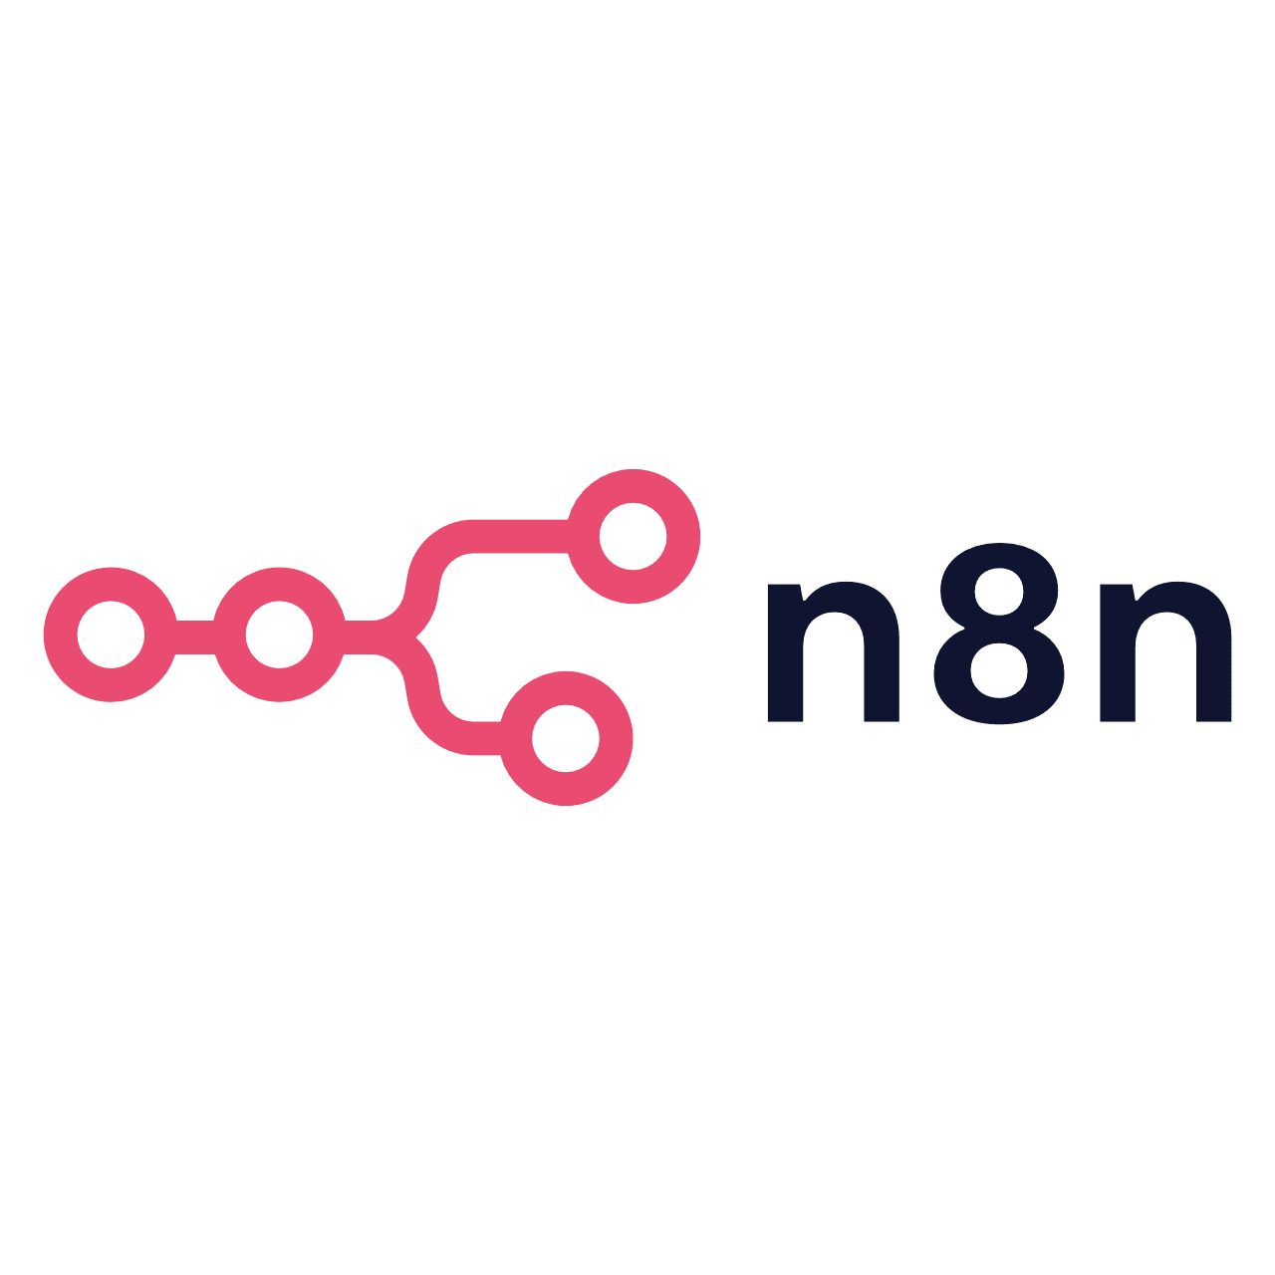
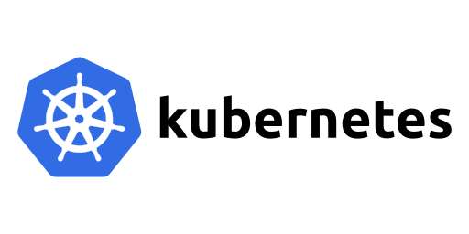
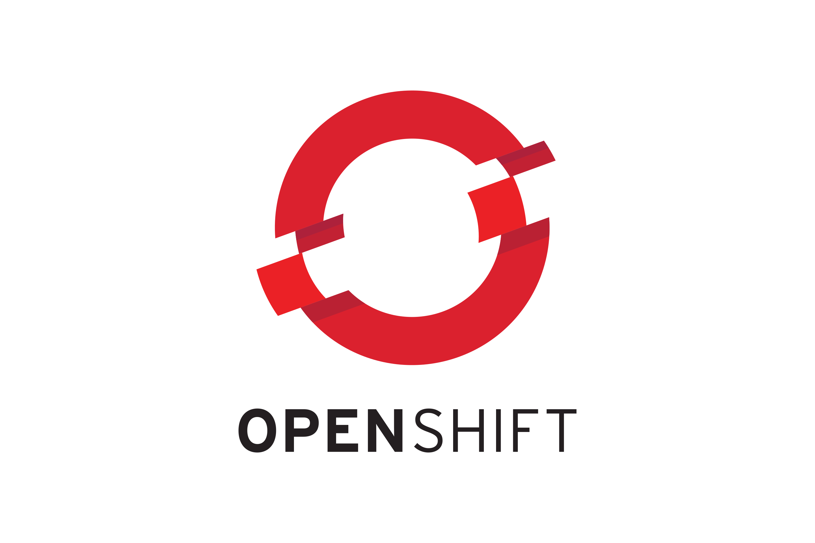
Blueprint Agentic Architecture
Defines technology, operation and how to connect to the company capabilities
Front-ends & Interaction
Various Sources of Interaction with the Agent Platform
Agentic Platform – Agency Core
Hyperscaler Large Language Models (LLM)
CDAIO Domain
Agentic Engine Layer
Interoperability & Control Layer
Business Domains
Capabilites
Digital Channels
Web / Mobile / Chat
Model Ecosystem Interface
Agent Coordination
Planning configuration.
LLM Gateway
Makes dynamic decisions on cost, latency, and complexity to route prompts through a unified API, optimizing requests by rewriting, compressing context, and using embeddings.
Santander Business Domains
Assisted Channels
Contact Center / Branch
Multi-Agents
Business Backend Capabilities
Blackboard
Shared memory space for Multi-Agent collaboration.
Guardrails
Control Outputs, hallucination, wrong behaviour and other parameters
Business Backend Capabilities
Models
Ecosystem
Corporate Apps
Memory & Knowledge Ecosystem Interface
Finetuning
Prompts
Agent Evaluation
Feedback
Custom Models
Flows
Real-world enterprise processes —such as card dispute reconciliation, contract compliance review, or wealth management— require persistent agents capable of multi-step planning, tool use, and asynchronous execution.
Memory Broker
Acts as an interface between agentic systems and graph or vector databases where long-term memory, semantic, episodic and other kinds of memory are stored.
Agent Gateway
Unified Entry Point for Orchestration.
Episodic memory Formation
Generates Memory episodes as past experiences to work better at each iteration.
Knowledge
Knowledge Base
Hybrid RAG (Vector + Graph) business rules, operation manuals, etc.
RAG
Vector & Graph
Data Capabilities
Structured data ingestion, processing, and management for AI use.
Data Systems
Governance
Secure Code Runtime
Sandbox (WASM/gVisor) for isolated execution of agent-generated Python/SQL code.
Corporate features and APIs available to fully integrate agents
Tool Ecosystem Interface
Tools
Tool Proxy
Acts as gateway and control access to MCP tools, transform APIS into MCP tools and provides use control and monitoring.
MCP/API Server
Core banking APIs exposed as standard MCP services. Governance layer providing secure context..
Platform Capabilities
Tool Registry & Schema Store
Configurations
Inference parameters and security policies by environment.
Business Capabilities
PBC Capabilities
Agency Ecosystem Interface
Agency
Business Apps
Agency Capabilities (A2A)
Allows this agency to send work to other agentic agencies, using events, RPC calls or other techniques.
Agency Capabilities Registry
Central catalog of A2A roles and contracts to discover and reuse autonomous agents.
Other Agency Capabilities
Platform Operation
SDLC & DevSecOps
Adapted to the software development lifecycle and integrate DevSecOps tools to enhance security and efficiency throughout the process.
Platform & Infrastructure
Adapted to any cloud or platform via Blueprints. Auto-Scaling, resilience achieved using standards and company compliance.
AI Observability
Adapted to the company Observability,Traceability and accountability engines using standards like Opentelemetry
Accuracy, latency, failures, user satisfaction, cost, and performance can be monitor to improve production insight, detect issues early, supports optimization and A/B testing, and foster scalable trust.
Security
Adapted to the company security requirements on data lineage, consent, etc, to achieve full regulatory compliance.
OHE

Slide 14

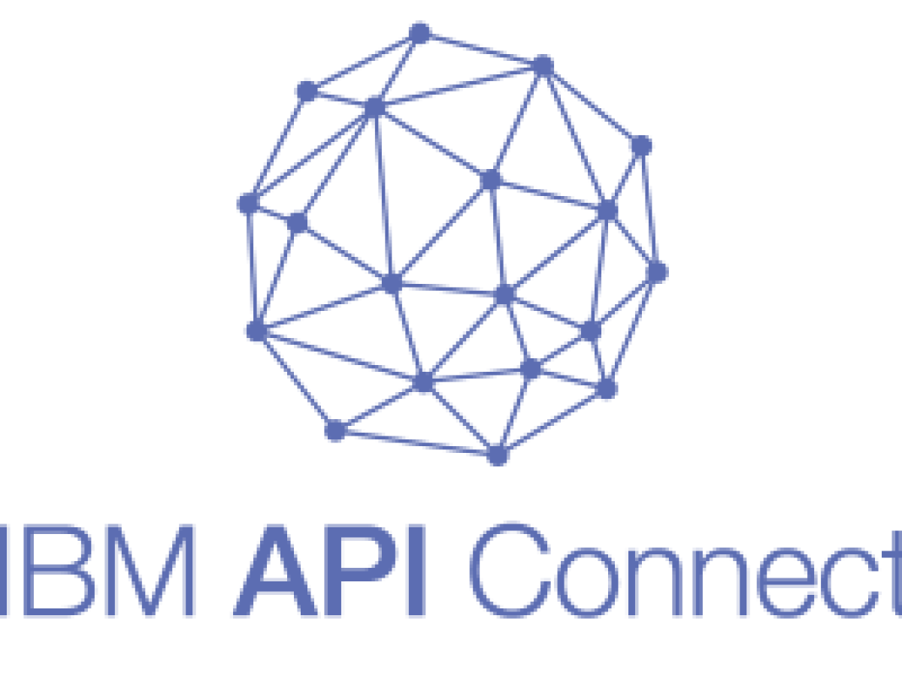
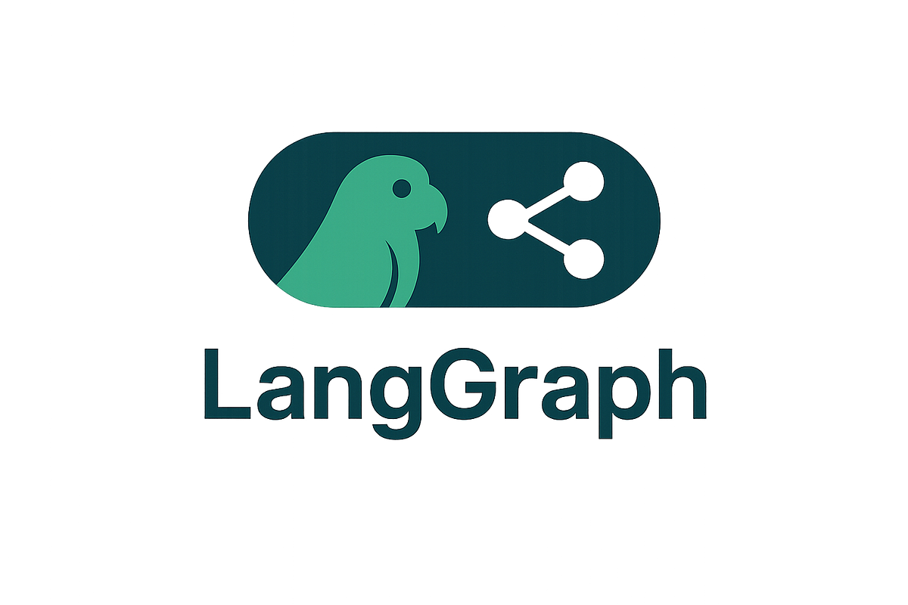
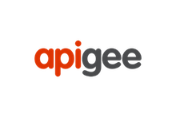









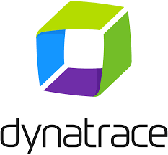




Blueprint Agentic Architecture
Defines technology, operation and how to connect to the company capabilities
Front-ends & Interaction
Various Sources of Interaction with the Agent Platform
Agentic Platform – Agency Core
Hyperscaler Large Language Models (LLM)
CDAIO Domain
Agentic Engine Layer
Interoperability & Control Layer
Business Domains
Capabilites
Digital Channels
Web / Mobile / Chat
Model Ecosystem Interface
Agent Coordination
Planning configuration.
LLM Gateway
Makes dynamic decisions on cost, latency, and complexity to route prompts through a unified API, optimizing requests by rewriting, compressing context, and using embeddings.
Santander Business Domains
Assisted Channels
Contact Center / Branch
Multi-Agents
Business Backend Capabilities
Blackboard
Shared memory space for Multi-Agent collaboration.
Guardrails
Control Outputs, hallucination, wrong behaviour and other parameters
Business Backend Capabilities
Models
Ecosystem
Corporate Apps
Memory & Knowledge Ecosystem Interface
Finetuning
Prompts
Agent Evaluation
Feedback
Custom Models
Flows
Real-world enterprise processes —such as card dispute reconciliation, contract compliance review, or wealth management— require persistent agents capable of multi-step planning, tool use, and asynchronous execution.
Memory Broker
Acts as an interface between agentic systems and graph or vector databases where long-term memory, semantic, episodic and other kinds of memory are stored.
Agent Gateway
Unified Entry Point for Orchestration.
Episodic memory Formation
Generates Memory episodes as past experiences to work better at each iteration.
Knowledge
Knowledge Base
Hybrid RAG (Vector + Graph) business rules, operation manuals, etc.
RAG
Vector & Graph
Data Capabilities
Structured data ingestion, processing, and management for AI use.
Data Systems
Governance
Secure Code Runtime
Sandbox (WASM/gVisor) for isolated execution of agent-generated Python/SQL code.
Corporate features and APIs available to fully integrate agents
BAMOE
Tool Ecosystem Interface
Tools
IDP Broker
Tool Proxy
Acts as gateway and control access to MCP tools, transform APIS into MCP tools and provides use control and monitoring.
MCP/API Server
Core banking APIs exposed as standard MCP services. Governance layer providing secure context..
Platform Capabilities
Tool Registry & Schema Store
Configurations
Inference parameters and security policies by environment.
Business Capabilities
PBC Capabilities
RPA
Agency Ecosystem Interface
Agency
Business Apps
Agency Capabilities (A2A)
Allows this agency to send work to other agentic agencies, using events, RPC calls or other techniques.
Agency Capabilities Registry
Central catalog of A2A roles and contracts to discover and reuse autonomous agents.
Other Agency Capabilities
FMIS
SANART
Platform Operation
TITULIZATIONS
SDLC & DevSecOps
Adapted to the software development lifecycle and integrate DevSecOps tools to enhance security and efficiency throughout the process.
Platform & Infrastructure
Adapted to any cloud or platform via Blueprints. Auto-Scaling, resilience achieved using standards and company compliance.
AI Observability
Adapted to the company Observability,Traceability and accountability engines using standards like Opentelemetry
Accuracy, latency, failures, user satisfaction, cost, and performance can be monitor to improve production insight, detect issues early, supports optimization and A/B testing, and foster scalable trust.
Security
Adapted to the company security requirements on data lineage, consent, etc, to achieve full regulatory compliance.
OHE

Slide 15
Blueprint Agentic Architecture. Modular Architecture
AgenticAI is a modular, cloud-agnostic platform that empowers organizations to adopt, extend, or integrate agentic capabilities. Either through its full-stack deployment or by leveraging specific components as accelerators for custom AI solutions.
1
API Spec OpenAPI/Swagger
Source of truth for contract-driven MCP generation.
Composable & Modular Architecture: Each core capability—such as prompt management, memory brokering, observability, and the agent catalog—can be used independently or as part of a unified platform.
Platform Components as Accelerators: Each module is designed in a plugin-ready format, allowing organizations to reuse them as building blocks to accelerate the development of custom platforms or agentic solutions. This modularity enables seamless integration with other agent implementations, internal tools, or AI ecosystems—maximizing flexibility and reducing time-to-build.
Execution of Agents Developed Outside the Platform: Agents or multi-agent systems developed outside AgenticAI—using external frameworks—can be executed within the platform. To ensure seamless integration and full observability, these agents may require minor adjustments to align with core components such as memory management, observability, and the Agency Catalog.
Cloud-Agnostic Deployment: The platform can be deployed in any major cloud environment—Azure, GCP, or AWS—ensuring alignment with your existing cloud strategy and governance model.
Framework Interoperability: Fully compatible with leading agent frameworks like LangGraph, CrewAI, and Semantic Kernel, enabling teams to build with their preferred orchestration tools.
Integration with Hyperscaler Ecosystems: Natively integrates with agent development platforms such as Vertex AI Agent Builder, Azure AI Foundry, and AWS Bedrock, allowing organizations to build on top of trusted foundations.
2
MCP Generator Scaffold
Automatic code generation of MCP servers and SDKs from specs.
3
Unit & Contract Tests
Schema, semantic, and backward-compatibility validation.
4
Static/Dynamic Sec (SAST/DAST)
Automated build and runtime vulnerability scans.
5
Policy Validation
Pre-deployment enforcement of authorization and compliance rules.
6
Publish to Registry
Controlled release into the global MCP catalog.
7
Promote to PRO (Blue/Green)
Safe deployment and monitored traffic shifting.
8
Observability
Unified dashboards for traces, cost, drift, and policy adherence.

Slide 16



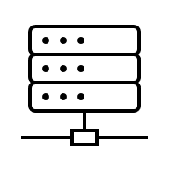


Agentic Architecture
FMIS Error Remediation
Data Sources
API Calls (Structured Data, Exchange Rate, STRATUS)
FMIS
Process Engine
Landing Data Layer
Common Data Layer
FMIS Oracle DB
(OFSAA)
M1 FMIS FILE (EQUATION: Accounting and non-accounting data)
Normalization & Data Quality process
ERROR?
NO
TTIs Calculated
Ingestion
YES
Output Manager
(BDH Operational Data)
FMIs Oracle DB
(Historical Data)
Data troubleshooting
YES
SOLVED?
Reports
NO
Output Manager
(BDH Operational Data)
•Transactions without an assigned product, which are entered manually in order to assign this product. (To do this, they consult the data on past dates and transactions.)
•Transactions where the closing date/financial year is inconsistent, with future dates or empty dates, which are corrected manually.
Agentic Platform
Error Remediation

Slide 17

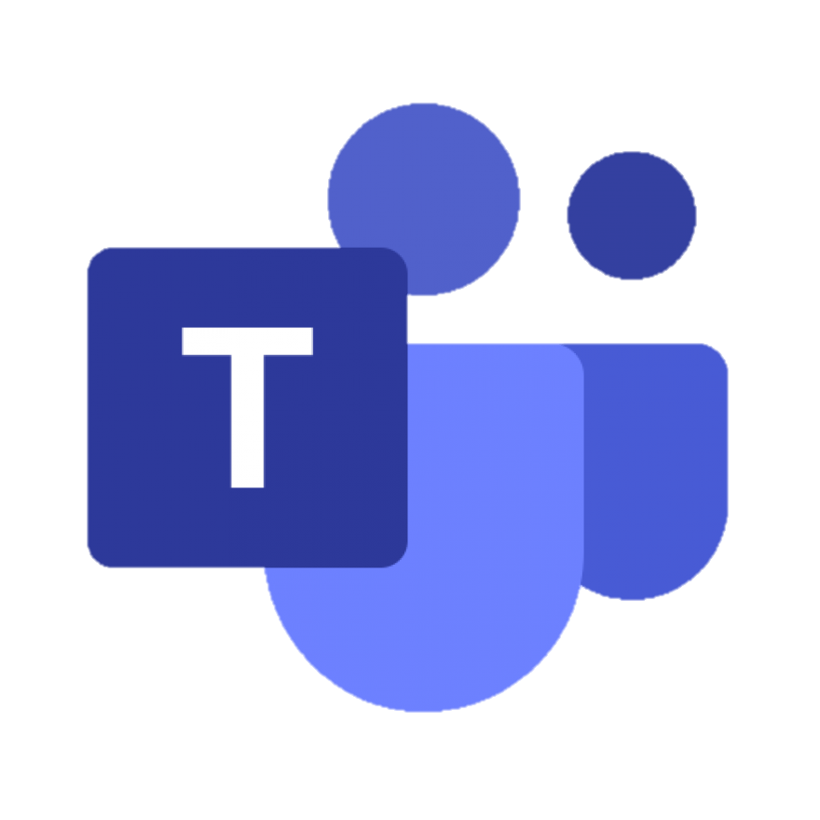

Agentic Architecture
Agent flow to check FMIS TTI
Agentic Platform
Orchestration
Agentic Platform
FMIS
This agent is responsible for receiving the notification and orchestrating the rest of the agents until the desired result is achieved
Information Analyst
COMMON DATA
Planning Pre-analysis, task orchestration, recovery of previous data
Monitoring and searching about an incorrect TTI
Analyzes and generates responses for the user
FMIS Oracle DB
FMIS
TTI is evaluated and analyzed
COMMON DATA
This agent is responsible for receiving the user's question, retrieving the information from the data sources, and generating a response to send to the user
Decision
tree
Information retrieval
Consolidation and analysis
Validation
Store results
Conversational Interface
FMIS Oracle DB
TTI Identification and Related Information
Information consolidation and data analysis
Verification of criteria, data, and conclusions
Store results to be consumed later
Decision
tree
This agent is responsible for connecting to the data source to retrieve information from the TTI and historical data
It is responsible for consolidating all the information received to analyze it and try to locate a reason for the change in the TTI
This agent validates from the information retrieved, the initial premises, and the analysis carried out, if everything is correct, or if there is any element or analysis that must be repeated and is returned to a previous phase
Once the task has been successfully executed, this agent is responsible for storing the information and analyses so that it can be consulted later
Does it explain the change in customer TTIs that have changed by more than 1 percentage point?
Why has the TTI changed compared to yesterday's calculation? -Why has this curve been used?
Identify which interest curve this customer's TTI was calculated with
Give me this client's TTIs

Slide 18
Agentic Architecture
Agent flow to provide responses to the customer SANART
Agentic Platform
What is the balance drawn down in EUR at the end of each month from 2024 onwards? In table format with the balance in EUR millions.
Could you compare, for each quarter, which deals (comparing by Deal Name) have seen a greater decrease in the balance drawn? Bring out a table including: *deal name, balance change (in millions of EUR), Booking unit, Product level 1, Product level 2.
Could you compare, for each quarter, which deals (comparing by Deal Name) have seen a greater increase in the balance drawn? Draw a table including: deal name, balance change (in millions of EUR), Booking unit, Product level 1, Product level 2.
Of the deals we have at HTCS each quarter, give me the signing date of each deal. Those that have a signature date of 3 months (<90 days) greater than the reporting date of each month, classify them as "Level 3 Assets". The rest, classify them as "Level 2 Assets". Make a board with:
Rows: Booking Unit, Columns: Signature
Date Buckets: Closing < 3m Closing < 6m Closing < 1y Closing < 2y Closing > 2y
Values: balance drawn in EUR
Orchestration
This agent is responsible for receiving the question and orchestrating the rest of the agents until the desired result is achieved
Question
Conversational Interface
Planning Pre-analysis, task orchestration, recovery of previous data
CSV/Json
CSV/Json
Power BI
SANART
Information retrieval
Consolidation and analysis
Validation
SANART
Oracle DDBB
Retrieve the query to execute or generate a query
Information consolidation and data analysis
Verification of Criteria, Data, and Conclusions
This agent will have a set of queries that it will use for common questions, or if it doesn't have any preconstructed, it will try to generate one on the fly
It is responsible for consolidating all the information received to analyze it and try to locate a reason for the change in the TTI
This agent validates from the information retrieved, the initial premises, and the analysis carried out, if everything is correct, or if there is any element or analysis that must be repeated and is returned to a previous phase

Slide 19
RPA Solution
04

Slide 20
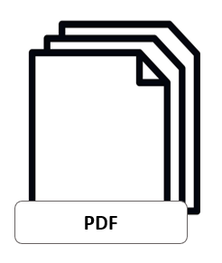




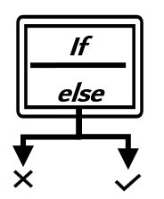


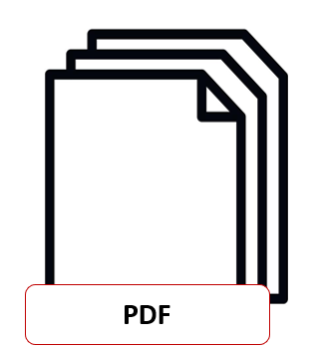
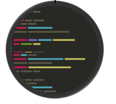
RPA Solution vs Agentic
Robotic Process Automation
Manually
Constructing via pull-and-drag
Controllable workflows ensure consistent outcomes but without flexibility for complex tasks
Can only handle rigid tasks
Remediation of errors
If ( )
If
else
Controllable workflows
Dynamic Environment
Automatically
Orchestrating & testing
Agentic Process Automation
Agentic Workflow
Description language
A data agent brings flexibility and the ability to adapt to changing circumstances.
PDF
Can handle rigid and flexible tasks
CONSTRUCTION
WORKFLOW
EXECUTION

Slide 21
Thank You.
Our purpose is to help people and businesses prosper.
Our culture is based on believing that everything we do should be:
Simple Personal Fair

Slide 22

Agentic Architecture
Required Capabilities: Target Architecture
Capabilities
Proprietary Agency Catalog as a decision-making and group federation engine. It ensures traceability and security in the exposure and use of agents, defines guardrails, governs multiple LLMs from different providers, manages the decision matrix, and is aligned with Market Watch.
Registration and Publication of New Agents, Multi-Agents, and Agencies
Decision Matrix (DMN) based on the LLM Model Catalog (review agency selection criteria):
Agencies: Include agents, multi-agents, and interact with other agencies. They expose capabilities.
Central Orchestrator Agency Catalog: Minimizes operational load on business units by guiding which agent to use.
Decision Matrix: Ensures each agent uses the appropriate LLM, providing differentiated value and justifying cost (AgNTTic broker). Centralized vs. distributed approach.
Intelligent Routing: Decision matrix for automatic routing of requests to the most suitable AI engine (LLM) based on cost, accuracy, latency, synchronous/asynchronous execution, and the LLM required to resolve the request (Gemini, ChatGPT, fine-tuned models).
Non-Functional Criteria-Based: Routing and agent selection are guided by non-functional requirements.
Orchestration Consistency: Ensures workflow behavior in non-deterministic cases and reliability of routing (catalog selects the correct agent according to the Decision Matrix).
Human Rubric: Handles complex use cases, e.g., DNI processing across 13 pages.
Stack Management: Avoid license duplication and over-provisioning through dynamic resource optimization when adopting multiple LLMs.
Governance and Audit: Unify control of usage policies and centralize calls to multiple providers (multi-LLM).
Request → Central Orchestrator Agent → Catalog/Decision Matrix (DMN) Lookup → Routing to Specialized Agent (MAISA/Watson/N8N/AWS Quick Automate)
Ensure alignment with the Data & Analytics team for catalog development.
MCP Gateway: Secure and Profiled Access
MCP Gateway Architecture Design at Group Level
Define usage criteria compared to a traditional API Gateway and select the product.
Implement different security levels.
Manage exposure of employee data, client information, and sensitive data.
Involve Security and CISO teams.
Traceability and Observability: Ensure complete logging of all service interactions.
Security and Profiling: Strict access policies, including identity verification (employee vs. client) and management of data sensitivity levels.
Security Policies (RBAC)
APIs for Specialized Agents
Access to credentials/systems with manual verification.

Slide 23
Agentic Architecture
Pain Points
Technological Complexity and Fragmentation
The coexistence of multiple platforms and tools leads to duplicated functions, high maintenance costs, the need for specialized knowledge, and difficulties in scaling solutions consistently across countries. Should orchestration be centralized? There is a risk of operational inconsistency and fragmented versions due to product releases (quarterly unified release management at the Core AI Automation level).
Lack of Governance and Centralized Orchestration
The lack of a single control point leads to inefficiencies in decision-making, execution inconsistencies, and a risk of cost overruns due to limited global visibility. New products may experience feature overexposure.
Difficulty in Justifying Differentiated Value
The overlap of similar capabilities across platforms makes it difficult to demonstrate the return on investment for each tool and slows adoption by local units.
Limited Agility in Technology Adoption
The validation and deployment processes for new solutions are slow and approval-dependent, reducing responsiveness to business needs and affecting competitiveness (Time-to-Market). There is a lack of agility in readiness.
Risk of Cost Overruns and Infrastructure Duplication
The lack of unified criteria for platform selection and usage increases the risk of paying for redundant licenses and resources, impacting operational efficiency.
Technological Obsolescence
Persistence of critical systems and workflows on outdated, obsolete platforms poses security, compliance, and maintenance risks, requiring urgent controlled migration plans. Functional analysis automation and the capability to automate workflows with end-to-end testing are needed.
Capability C: Agile Enablement of Specialized Execution
Ensure agility and differentiated value at the execution layer, focusing on:
Execution Efficiency: Accelerate the integration and validation of new technologies to increase accuracy and reduce operational costs.
Operational Consistency: Enforce a discipline of single releases and versions globally to mitigate the risk of fragmentation and operational inconsistency across entities.

Slide 24
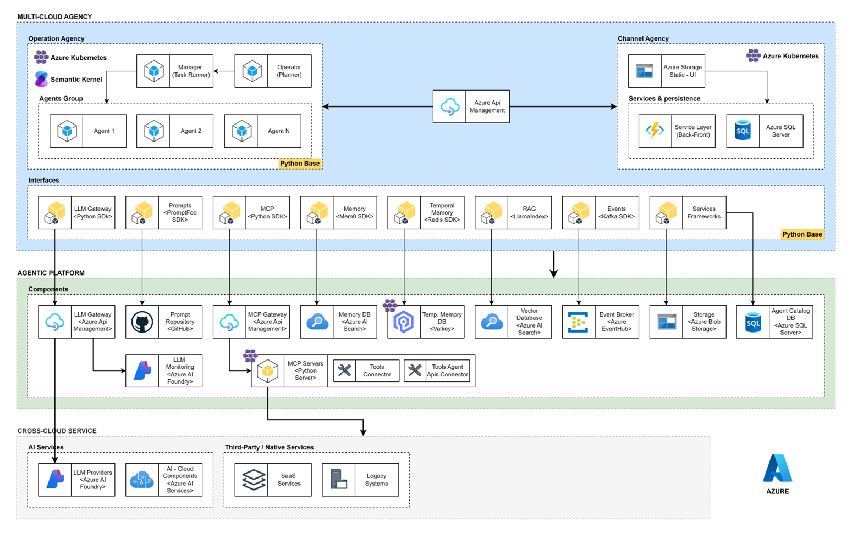
Agentic Architecture
AgNTTic Azure Components

Slide 25
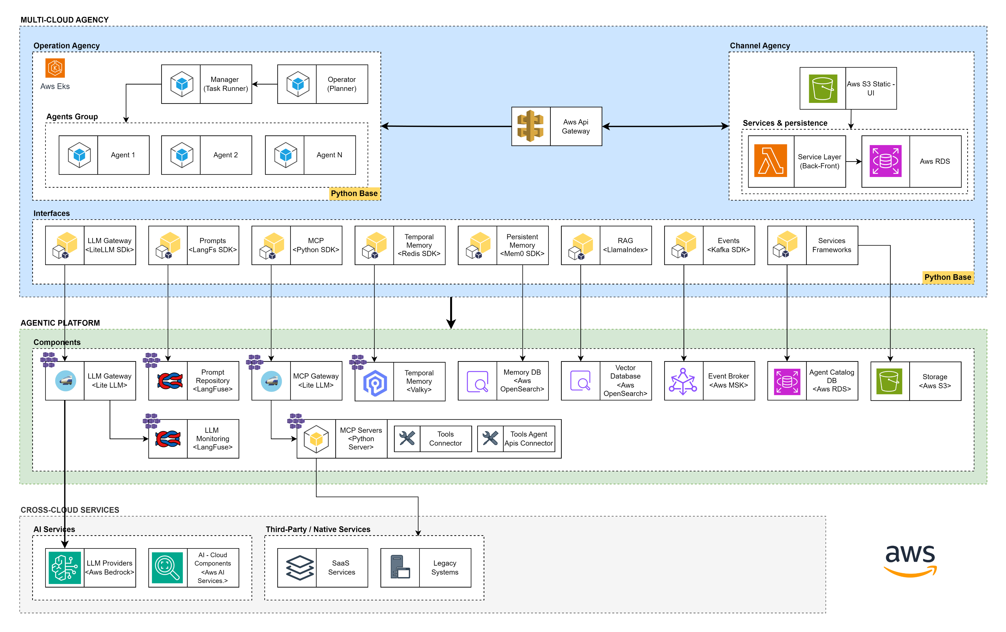
Agentic Architecture
AgNTTic AWS Components

Slide 26

Agentic Architecture
AgNTTic Main Capabilities
This framework diagram illustrates a corporate multi-agent platform, organizing capabilities into external client interfaces, agent management, GenAI infrastructure, and platform components, designed to orchestrate intelligent agents with robust governance, evaluation mechanisms, and integration capabilities for enterprise deployment.
External interactions
Agentic Platform
GenAI and Data Capabilities
Data Capabilities
Structured data ingestion, processing, and management for AI. use
People
Management Portal A centralized interface to manage the full lifecycle of agents and platform operational components. It includes dashboards, configuration tools, monitoring views, and development utilities.
Agent Catalog
The Agency Catalog plays a critical role in the multi-agent corporate platform by serving as a centralized record of all agents, tools, and capabilities for operational and governance purposes.
Resources
It supports modules that provide basic capabilities to agents, such as tool execution through MCP, agent-to-agent communication, memory persistence, context delivery, and performance measurement.
LLM Gateway
Multiple model sources and adaptation options.
Knowledge Databases (RAG)
Efficient retrieval and relational storage for agent reasoning.
Applications
Agent Coordination
The orchestration layer that governs how multiple agents and agencies interact, assign tasks, and share context to complete complex objectives.
Agent Evaluation & Monitoring
Mechanisms for evaluating and validating agent performance, quality, and compliance, including automated security barriers, LLM-based judgment, and human supervision.
Corporate Capabilities
MCP Server
Governance layer providing secure context and tool-based access to Corporate tools
Tools
Corporate features and APIs available to fully integrate agents
Events & Probes
MCP Client
A2A
Corporate Agents
Other corporate agents build or run corporate platforms, sales force, ServiceNow, etc. with A2A capabilities
Legend of component types
Platform Operation
Safety
Monitoring and observability
CI / CD
Governance
Pre-existing components
Notes:
Buscar en slide 17 por si identificamos algo adicional

Slide 27

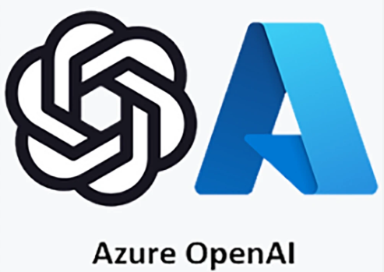
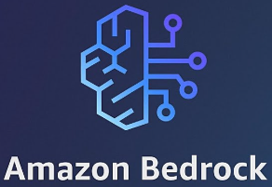





Agentic Architecture
The operator provides mission objectives to the agent to perform specific actions. Communication occurs through events.
AgNTTic Components
1
Event Backbone: Event-based choreography allows for easy integration, interaction coordination, setup, and discovery
Agents interact with the environment through events in a dynamic way, making decisions based on both internal reasoning and external feedback. The process usually involves three key components: Thinking, Acting, and Observing.
Tool: They are specific components in charge of carrying out actions with third systems.
2
Blackboard:
Shared knowledge repository that enables agent collaboration and coordination of problem resolution.
The built framework is fully adaptable and cloud-agnostic, where agents can interact with multiple LLMs through one facade
Blackboard
3
Observability
Agency Cards: Managed by protocols such as A2A and ACP we can send and receive tasks from/to other agencies
Tool
Event Backbone
Contextualizer: Component that creates and retrieves knowledge for agents and synthesizes previous experience
MCP
5
Agentic Solution
1
In order to consolidate previous experience and provide the required knowledge to the different agents, there is a context manager that stores all the information in a knowledge store. This provides global memory and shared context for agents.
Agency Cards
Agent
7
Contextualizer
4
Agent Operator
2
Agent
Context Backbone
Operator: Component that standardizes and simplifies communication with agents in terms of configuration capabilities
4
Tools provide capabilities to perform specific actions, such as calling API components or integrating with third-party systems.
Agent
Agent Evaluator
5
Facade
Agent Evaluator: Component that assesses that the objective has been planned correctly. Pattern Reflection.
The agent evaluator reviews the plans made, making sure they fit as expected by relying on long-term memory and passing experiences.
6
6
Agent: Various agents perform different actions based on specific use cases based on a ReAct pattern. Each agent has a different role and different statuses
3
Context Backbone: Knowledge storage
Sending tasks or receiving tasks from other agencies is handled using A2A/ACP protocols to allow the ability to interact with agent capabilities from other domains. It is to orchestrate the different capacities of the department in a totally autonomous way.
7

Slide 28












Agentic Architecture
Santander with AgNTTic
Platform Explained
Operator: component that standardizes and simplifies communication between humans and agents/agencies
Agency: A group of agents capable of processing complex problems through autonomy and reasoning capacity in collaboration with other agents.
Agents: Agents that perform different actions depending on cases on specific domains.
Evaluator: Evaluate that the goal has been planned correctly
Backbone: choreography based on Kafka (or similar) allows easy interoperability between agents
Blackboard: Shared knowledge repository that enables agent collaboration and coordination of problem resolution
Contextualizer: Component that creates and remembers knowledge for agents and synthesizes previous experiences
Context backbone: Knowledge and storage
Observation: Component capable of identifying and governing agent behavior (helicopter view)
Tools: Specific components responsible for performing deterministic actions
Ollama
Ollama
OpenAI
Gemini
Contextualizer
Agentic IT Platform
Bedrock
Context Backbone
Large Language Models
Evaluator
Gluon
LLM Catalog
Legacy
MCP GW
Santander CIB tooling
LoB
Architec.
Agency Cards
Development Agency
Plat. Eng.
Observation
Operations
Backboard
Modernization Agency
Event Backbone
Security
<< Code >>
Agent Operator
<< Conf. >>
Site Reliability Eng.
<< Ops >>
Titulizations
SANART
<< Prompt >>
FMIS
Santander CIB Applications
Legend of component types
Agencies on the platform
Tools needed for activity resolution
Individual agents with specific expertise

Slide 29
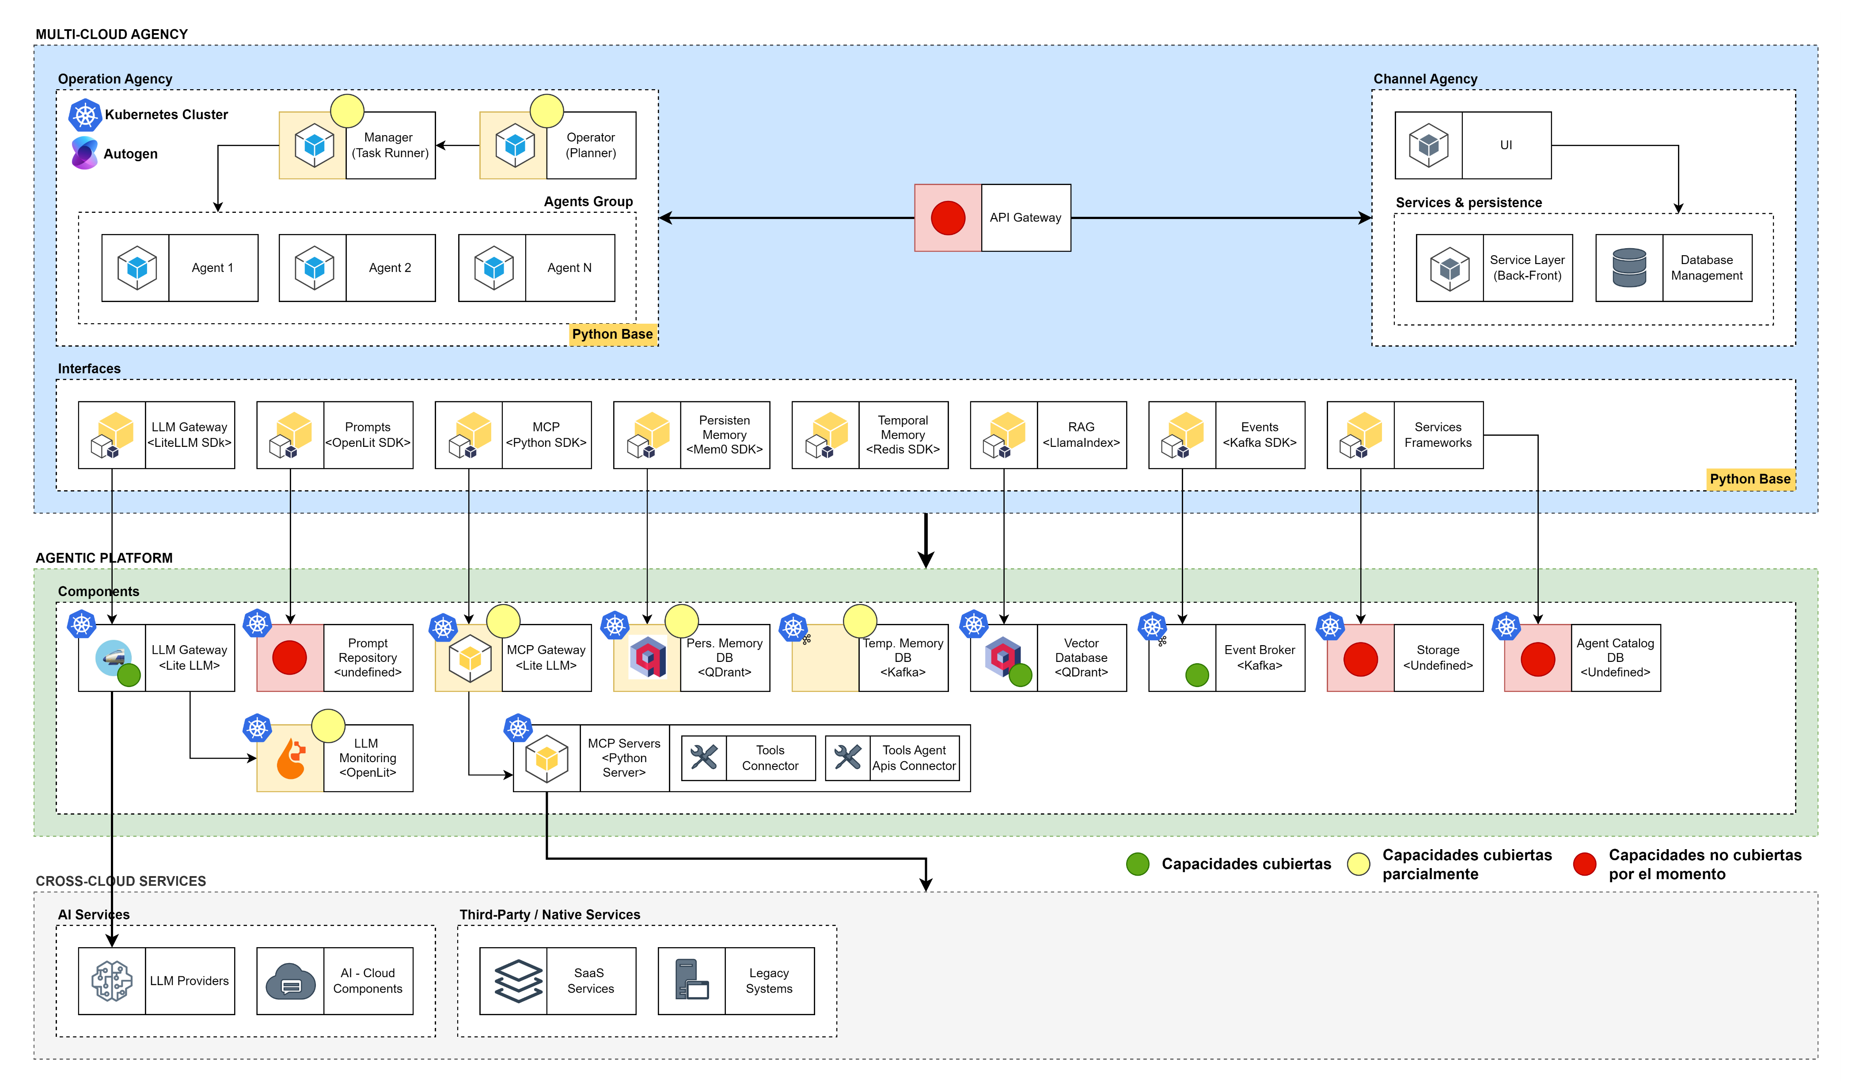

Agentic Architecture
AgNTTic Vendor Agnostic Components

Slide 30

Agentic Architecture
FMIS Error Remediation
Data Sources
FMIS
Agentic Platform
Ingestion
LLM Catalog
API Calls (Structured Data, Exchange Rate, STRATUS)
Process Engine
Error remediation prompt
Agent
LLM Brain Decision
ERROR?
YES
.
.
.
M1 FMIS FILE (EQUATION: Accounting and non-accounting data)
NO
MCP GW
Tools
Memory
Knowledge
Operator/Evaluator Agent
.
.
.
Long Term
Short Term
Episodic
FMIs Oracle DB
Output Manager
(BDH Operational Data)
Oracle Tool
Vector Database
Semantic Database
email
Tool
sNow
Tool
Output Manager
(BDH Operational Data)
Dashboard
error display
sNow
Operaciones sin producto asignado, que para asignar este producto lo introducen manualmente..(para hacer esto, consultan el dato de fechas y operaciones pasadas,)
Operaciones donde la fecha de cierre/ejercicio, es incoherente, fechas a futuro o fechas vacías, que las corrigen manualmente.
RECOMENDACIONES
NO DEBERIAMOS METER UNA PLATAFORMA AGENTICA, SE HARÁ UN PROCESO QUE RECOJA INFORMACION DE DIAS ANTERIORES
eMail
User
Notes:
Prompt del caso de uso

Slide 31

Agentic Architecture
FMIS TTIs queries
FMIS
Agentic Platform
LLM Catalog
COMMON DATA
Validate Error TTI for clients
FMIS Oracle DB
Agent
LLM Brain Decision
Evaluator Agent
Decision
tree
MCP GW
Tools
Memory
Knowledge
Operator/Evaluator Agent
.
.
.
Long Term
Short Term
Episodic
Oracle Tool
Agent Serving the Chatbot
Vector Database
Semantic Database
Process Engine
Conversational Interface
email
Tool
TTI ERROR?
YES
NO
Does it explain the change in customer TTIs that have changed by more than 1 percentage point?
Why has the TTI changed compared to yesterday's calculation? -Why has this curve been used?
Identify which interest curve this customer's TTI was calculated with
Give me this client's TTIs
Calculated TTIs
Para la variación de las TTIs, debe ser un procesamiento en SPARK,
User
.
Pull de agentes que da servicio al chatbot
Agente verificador

Slide 32
Agentic Architecture
Disclaimer
Querys sencillas, apuntando a una única tabla, para que no haga joins
SANART
Data Sources
Agentic Platform
SANART
LLM Catalog
FMIS
Ingestion
SANART Oracle DDBB
Validate TTI for all clients
Agents
LLM Brain Decision
.
.
.
AQUA+
Ratings
MCP GW
Tools
Memory
Knowledge
Operator/Evaluator Agent
Power BI
Capital
Monthly closing
.
.
.
Long Term
Short Term
Episodic
Oracle Tool
Vector Database
Semantic Database
Stratus
Clients
Conversational Interface
What is the balance drawn down in EUR at the end of each month from 2024 onwards? In table format with the balance in EUR millions.
Could you compare, for each quarter, which deals (comparing by Deal Name) have seen a greater decrease in the balance drawn? Bring out a table including: *deal name, balance change (in millions of EUR), Booking unit, Product level 1, Product level 2.
Could you compare, for each quarter, which deals (comparing by Deal Name) have seen a greater increase in the balance drawn? Draw a table including: deal name, balance change (in millions of EUR), Booking unit, Product level 1, Product level 2.
Of the deals we have at HTCS each quarter, give me the signing date of each deal. Those that have a signature date of 3 months (<90 days) greater than the reporting date of each month, classify them as "Level 3 Assets". The rest, classify them as "Level 2 Assets". Make a board with:
Rows: Booking Unit, Columns: Signature
Date Buckets: Closing < 3m Closing < 6m Closing < 1y Closing < 2y Closing > 2y
Values: balance drawn in EUR
BDH
Amortization schedule, the different types of FIS, counter-participant.
CSV/Json
Monthly files
of different equipment for the calculation of metrics (manual loading)
User

Slide 33
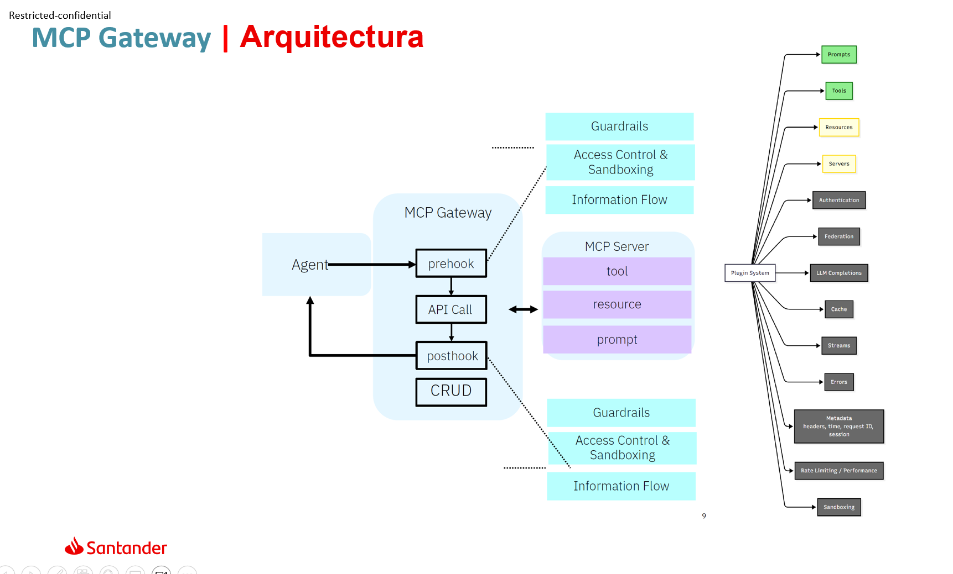
CDAIO Domains. Blueprint & Capabilites definition
Blueprint Agentic Architecture
Front-ends & Interaction sources
Las fuens de interacción con agentes pueden ser diversas
Agentic Platform – Agency Core
Hyperscaler Large Language Models (LLM)
Business Domains
Agentic Integration Layer
Agentic
Cognitive Gateway & Trust Layer
Any decision goes through here
Interoperability & Control Layer
Standarizes communication with internal tools/APIs and prevents vendor lock-in
Digital Channels
Web / Mobile / Chat
Framework
Agent Gateway
Unified Entry Point for Orchestration.
Assisted Channels
Contact Center / Branch
Input Engineering & Routing
Context Injection (RAG) and Prompt Management.
Capabilites
Agent Coordination
Planning configuration.
Tool Registry & Schema Store
Central repository of interface contracts (API/MCP) with technical schemas (Swagger/OpenAPI/MCP JSONs) for secure and typed integration.
Multi-Agents
Smart Routing & Optimization
(The Brain)
Decides where the prompt goes, exposing a unified API to all cognitive models and reasoning engines, and how to optimize it by rewriting requests, compressing context, and using embeddings.
Santander Business Domains
Corporate Apps
Single point of entry where the user interacts with "Co-pilots" who understand the context of the business.
Blackboard
Shared memory space for Multi-Agent collaboration.
Business Backend Capabilities
Flows
Real-world enterprise processes —such as card dispute reconciliation, contract compliance review, or wealth management— require persistent agents capable of multi-step planning, tool use, and asynchronous execution.
LLM Gateway Models & Training
Dynamic decision based on cost, latency, complexity, fallback.
Models
Ecosystem
Agent Evaluation
Feedback/QA.
Finetuning
Prompts
Trust & Security
(The Shield)
Ensure real-time data sovereignty and regulatory compliance. Run Personally Identifiable Information (PII)cleaning and masking, validate data schemas, and manage the secret lifecycle. It centralizes authentication and authorization, applying governance policies and Conversational Guardrails on all cognitive traffic to shield interactions.
Custom Models
Secure Code Runtime
Sandbox (WASM/gVisor) for isolated execution of agent-generated Python/SQL code.
Events
APIs
Rest
Knowledge & Memory
Hybrid RAG (Vector + Graph) for long-term context.
Knowledge
& Data
RAG
Vector & Graph
Data Capabilities
Structured data ingestion, processing, and management for AI use.
Internal Catalog
A centralized discovery catalog avoids "Shadow AI." contains only the discovery metadata (who can use what)
Memory Broker
La Coherence management between ephemeral and persistent memory is resolved as a transversal service.
Data Systems
Governance
Corporate features and APIs available to fully integrate agents
Tools
Agency Capabilities
Central catalog of A2A roles and contracts to discover and reuse autonomous agents.
MCP Server
Core banking APIs exposed as standard MCP services. Governance layer providing secure context..
Platform Capabilities
MCP Proxy / Tool Layer
Standard Tool Servers & Secure Execution.
Business Capabilities
PBC Capabilities
Business Apps
Tool Permisions / Access
Authorization Matrix (RBAC) that validates which agents can run specific tools and their quotas.
Agency Capabilities (A2A)
Service Mesh / Event Bus
Kafka backbone for event-driven and A2A (Agent-to-Agent) coordination.
Agency
Corporate Agent
Agents build or run corporate platforms, sales force, ServiceNow, etc with A2A capabilities.
Other Agency Capabilities
Configurations
Inference parameters and security policies by environment.
Output Engineering & Guardrails
Validate JSON schemas, semantic guardrails and secure connection with Flow Engines.
Platform Operation & LLMOps
It ensures the life cycle, quality, cost control, traceability and that the computing remains under total control of Santander
Sovereignty and Portability
EKS/AKS/On-prem & Cloud Native deployment. Auto-Scaling Platform (IaaC)
Resilience & LLMOps
Prompt Registry (Git-based), CI/CD Evaluation, Release Manager, Blue/Green Deployment, Roolback. Ensures operational continuity
End-to-End Observability
Traces/Cost/Risk (OpenTelemetry/Jaeger), FinOps, Performance Metrics
Security
Vault: data lineage, consent, and regulatory compliance. Secrets Manager: centralized cryptographic custody and rotation of credentials)
Enfoque en Puntos de Prueba (Proof Points)
La arquitectura está construida sobre las siguientes disciplinas críticas:
1. Soberanía del Cómputo: El runtime se encapsula utilizando Helm Charts y se despliega en infraestructura del cliente (EKS/AKS/On-prem), asegurando la portabilidad.
2. Rigor LLMOps: La calidad se garantiza mediante un ciclo de vida completo: registro de prompts, evaluación rigurosa (usando marcos CI/CD) y despliegue controlado.
3. Observabilidad Unificada: Trazas completas (Ej. Jaeger) y paneles de control (Ej. Grafana) proveen métricas de coste, rendimiento y adherencia a políticas, esenciales para sectores regulados.
4. Desacoplamiento del Modelo: El Cognitive Gateway permite que el agente sea agnóstico al LLM subyacente, realizando enrutamiento semántico basado en criterios de negocio y técnicos (coste/latencia).
5. Código Determinista: Se utiliza Sandbox WASM/gVisor/fRee en el Code Execution Runtime para garantizar la ejecución determinista y acotada del código generado por LLMs, mitigando riesgos de seguridad y consumo de recursos.
La soberanía, en el contexto de la Plataforma AgeNTTic, se define mediante tres pilares:
Independencia del Modelo: La capacidad de intercambiar el modelo fundacional subyacente (e.g., de GPT-4o a Claude 3.5 Sonnet o a un modelo Llama 3 local) sin reescribir la lógica del agente.
Residencia del Estado: Asegurar que la memoria del agente (contexto, historial de herramientas, y "pensamientos" intermedios) resida en infraestructura controlada por el cliente.
Gobierno de la Ejecución: Poseer el "Gateway Cognitivo" que enruta los prompts, imponiendo políticas de seguridad y coste antes de que cualquier dato abandone el perímetro seguro.¹
Acciones empresariales seguras y auditables.
Arquitectura Modular y Agnóstica a la Nube
Capa razonamiento cognitivo y la adaptabilidad semántica
Aceleradores de Plataforma como Bloques de Construcción
El modelo de adopción flexible permite que organizaciones maduras utilicen componentes específicos como "aceleradores". Por ejemplo, un equipo que ya tiene agentes en producción puede adoptar solo el LLM Gateway para controlar costes, sin migrar toda su lógica al catálogo de la plataforma. Del mismo modo, la capacidad "Multi-framework" ¹ es vital: la plataforma orquesta agentes construidos en LangGraph, CrewAI o Semantic Kernel indistintamente, actuando como el pegamento de interoperabilidad.

Slide 34












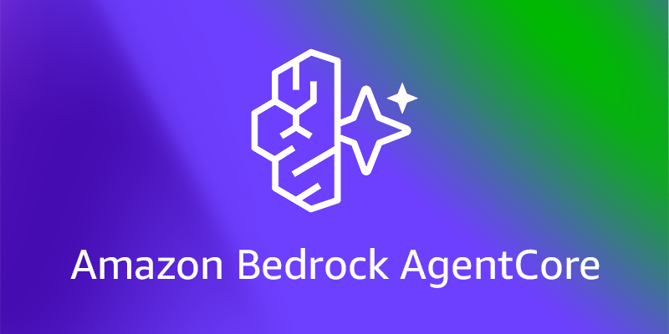
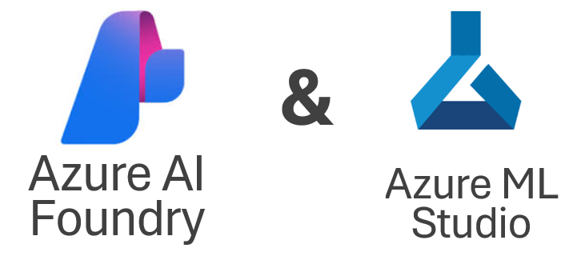

Blueprint Agentic Architecture. Santander overview
Interactions
Agentic Platform – Agency Core
Hyperscaler Large Language Models (LLM)
Digital Channels
Web / Mobile / Chat
Agentic Integration Layer
Agentic
Cognitive Gateway & Trust Layer
Any decision goes through here
Interoperability & Control Layer
Standarizes communication with internal tools/APIs and prevents vendor lock-in
Framework
Events
APIs
Rest
Agent Gateway
Unified Entry Point for Orchestration.
Assisted Channels
Contact Center / Branch
Input Engineering & Routing
Context Injection (RAG) and Prompt Management.
Capabilites
Agent Coordination
Planning configuration.
Tool Registry & Schema Store
Central repository of interface contracts (API/MCP) with technical schemas (Swagger/OpenAPI/MCP JSONs) for secure and typed integration.
Multi-Agents
Smart Routing & Optimization (The Brain)
Decides where the prompt goes, exposing a unified API to all cognitive models and reasoning engines, and how to optimize it by rewriting requests, compressing context, and using embeddings.
Santander Business Domains
Corporate Apps
MAISA
Business Domains
Microsoft Teams
Single point of entry where the user interacts with "Co-pilots" who understand the context of the business.
Blackboard
Shared memory space for Multi-Agent collaboration.
Business Domains
Flows
Real-world enterprise processes —such as card dispute reconciliation, contract compliance review, or wealth management— require persistent agents capable of multi-step planning, tool use, and asynchronous execution.
LLM Gateway Models & Training
Dynamic decision based on cost, latency, complexity, fallback.
Models
Ecosystem
Agent Evaluation
Feedback/QA.
Finetuning
Prompts
Trust & Security
(The Shield)
Ensure real-time data sovereignty and regulatory compliance. Run Personally Identifiable Information (PII)cleaning and masking, validate data schemas, and manage the secret lifecycle. It centralizes authentication and authorization, applying governance policies and Conversational Guardrails on all cognitive traffic to shield interactions.
Custom Models
Secure Code Runtime
Sandbox (WASM/gVisor) for isolated execution of agent-generated Python/SQL code.
Knowledge & Memory
Hybrid RAG (Vector + Graph) for long-term context.
Knowledge
& Data
RAG
Vector & Graph
Data Capabilities
Structured data ingestion, processing, and management for AI use.
Internal Catalog
A centralized discovery catalog avoids "Shadow AI." contains only the discovery metadata (who can use what)
Memory Broker
La Coherence management between ephemeral and persistent memory is resolved as a transversal service.
Data Systems
Governance
CIB
BAMOE
IDP Broker
Resilience & Ops
(The Infrastructure)
It ensures operational continuity and scalability of cognitive APIs. Implement High Availability (HA) mechanisms, load balancing, intelligent caching, and retry policies to mitigate failures. It acts as a central point of technical governance, guaranteeing the stability of the service against latency or outages from external providers.
Corporate features and APIs available to fully integrate agents
SDS
Tools
RPA
Agency Capabilities
Central catalog of A2A roles and contracts to discover and reuse autonomous agents.
MCP Server
Core banking APIs exposed as standard MCP services. Governance layer providing secure context..
Platform Capabilities
WM&I
MCP Proxy / Tool Layer
Standard Tool Servers & Secure Execution.
Business Capabilities
PBC Capabilities
SCF
Business Apps
Tool Permisions / Access
Authorization Matrix (RBAC) that validates which agents can run specific tools and their quotas.
HQ
FMIS
TITULIZATIONS
Agency Capabilities (A2A)
Service Mesh / Event Bus
Kafka backbone for event-driven and A2A (Agent-to-Agent) coordination.
Agency
Corporate Agent
Agents build or run corporate platforms, sales force, ServiceNow, etc with A2A capabilities.
Other Agency Capabilities
Global Cards
SANART
Configurations
Inference parameters and security policies by environment.
Output Engineering & Guardrails
Validate JSON schemas, semantic guardrails and secure connection with Flow Engines (BAMOE).
Platform
Platform Operation & LLMOps
It ensures the life cycle, quality, cost control, traceability and that the computing remains under total control of Santander
Sovereignty and Portability
EKS/AKS/On-prem & Cloud Native deployment. Auto-Scaling Platform
LLMOps
Prompt Registry (Git-based), IaC, CI/CD Evaluation, Release Manager, Blue/Green Deployment, Roolback
End-to-End Observability
Traces/Cost/Risk (OpenTelemetry/Jaeger), FinOps, Performance Metrics
Security
Vault: data lineage, consent, centralized cryptographic custody, rotation of credentials, and regulatory compliance
OHE

Slide 35
CDAIO Domains. Blueprint & Capabilites definition
Blueprint Agentic Architecture
Front-ends & Interaction sources
Las fuens de interacción con agentes pueden ser diversas
Agentic Platform – Agency Core
Hyperscaler Large Language Models (LLM)
Business Domains
Agentic Integration Layer
Agentic
Interoperability & Control Layer
Standarizes communication with internal tools/APIs and prevents vendor lock-in
Digital Channels
Web / Mobile / Chat
Internal Catalog
A centralized discovery catalog avoids "Shadow AI." contains only the discovery metadata (who can use what)
Framework
Agent Gateway
Unified Entry Point for Orchestration.
Assisted Channels
Contact Center / Branch
Agency Capabilities
Central catalog of A2A roles and contracts to discover and reuse autonomous agents.
Capabilites
Agent Coordination
Planning configuration.
Tool Registry & Schema Store
Central repository of interface contracts (API/MCP) with technical schemas (Swagger/OpenAPI/MCP JSONs) for secure and typed integration.
Multi-Agents
Santander Business Domains
Corporate Apps
Tool Permisions / Access
Authorization Matrix (RBAC) that validates which agents can run specific tools and their quotas.
Single point of entry where the user interacts with "Co-pilots" who understand the context of the business.
Blackboard
Shared memory space for Multi-Agent collaboration.
Business Backend Capabilities
Flows
Real-world enterprise processes —such as card dispute reconciliation, contract compliance review, or wealth management— require persistent agents capable of multi-step planning, tool use, and asynchronous execution.
LLM Gateway Models & Training
Dynamic decision based on cost, latency, complexity, fallback.
Models
Ecosystem
Agent Evaluation
Feedback/QA.
Configurations
Inference parameters and security policies by environment.
Finetuning
Prompts
Secure Code Runtime
Sandbox (WASM/gVisor) for isolated execution of agent-generated Python/SQL code.
Custom Models
Events
APIs
Rest
Knowledge & Memory
Hybrid RAG (Vector + Graph) for long-term context.
Knowledge
& Data
RAG
Vector & Graph
Data Capabilities
Structured data ingestion, processing, and management for AI use.
Cognitive Gateway & Trust Layer
Any decision goes through here
Memory Broker
La Coherence management between ephemeral and persistent memory is resolved as a transversal service.
Data Systems
Governance
Input Engineering & Routing
Context Injection (RAG) and Prompt Management.
Smart Routing & Optimization
(The Brain)
Decides where the prompt goes, exposing a unified API to all cognitive models and reasoning engines, and how to optimize it by rewriting requests, compressing context, and using embeddings.
Corporate features and APIs available to fully integrate agents
Tools
MCP Server
Core banking APIs exposed as standard MCP services. Governance layer providing secure context..
Platform Capabilities
Trust & Security
(The Shield)
Ensure real-time data sovereignty and regulatory compliance. Run Personally Identifiable Information (PII)cleaning and masking, validate data schemas, and manage the secret lifecycle. It centralizes authentication and authorization, applying governance policies and Conversational Guardrails on all cognitive traffic to shield interactions.
MCP Proxy / Tool Layer
Standard Tool Servers & Secure Execution.
Business Capabilities
PBC Capabilities
Business Apps
Agency Capabilities (A2A)
Service Mesh / Event Bus
Kafka backbone for event-driven and A2A (Agent-to-Agent) coordination.
Agency
Corporate Agent
Agents build or run corporate platforms, sales force, ServiceNow, etc with A2A capabilities.
Other Agency Capabilities
Output Engineering & Guardrails
Validate JSON schemas, semantic guardrails and secure connection with Flow Engines.
Platform Operation & LLMOps
It ensures the life cycle, quality, cost control, traceability and that the computing remains under total control of Santander
Sovereignty and Portability
EKS/AKS/On-prem & Cloud Native deployment. Auto-Scaling Platform (IaaC)
Resilience & LLMOps
Prompt Registry (Git-based), CI/CD Evaluation, Release Manager, Blue/Green Deployment, Roolback. Ensures operational continuity
End-to-End Observability
Traces/Cost/Risk (OpenTelemetry/Jaeger), FinOps, Performance Metrics
Security
Vault: data lineage, consent, and regulatory compliance. Secrets Manager: centralized cryptographic custody and rotation of credentials)
Enfoque en Puntos de Prueba (Proof Points)
La arquitectura está construida sobre las siguientes disciplinas críticas:
1. Soberanía del Cómputo: El runtime se encapsula utilizando Helm Charts y se despliega en infraestructura del cliente (EKS/AKS/On-prem), asegurando la portabilidad.
2. Rigor LLMOps: La calidad se garantiza mediante un ciclo de vida completo: registro de prompts, evaluación rigurosa (usando marcos CI/CD) y despliegue controlado.
3. Observabilidad Unificada: Trazas completas (Ej. Jaeger) y paneles de control (Ej. Grafana) proveen métricas de coste, rendimiento y adherencia a políticas, esenciales para sectores regulados.
4. Desacoplamiento del Modelo: El Cognitive Gateway permite que el agente sea agnóstico al LLM subyacente, realizando enrutamiento semántico basado en criterios de negocio y técnicos (coste/latencia).
5. Código Determinista: Se utiliza Sandbox WASM/gVisor/fRee en el Code Execution Runtime para garantizar la ejecución determinista y acotada del código generado por LLMs, mitigando riesgos de seguridad y consumo de recursos.
La soberanía, en el contexto de la Plataforma AgeNTTic, se define mediante tres pilares:
Independencia del Modelo: La capacidad de intercambiar el modelo fundacional subyacente (e.g., de GPT-4o a Claude 3.5 Sonnet o a un modelo Llama 3 local) sin reescribir la lógica del agente.
Residencia del Estado: Asegurar que la memoria del agente (contexto, historial de herramientas, y "pensamientos" intermedios) resida en infraestructura controlada por el cliente.
Gobierno de la Ejecución: Poseer el "Gateway Cognitivo" que enruta los prompts, imponiendo políticas de seguridad y coste antes de que cualquier dato abandone el perímetro seguro.¹
Acciones empresariales seguras y auditables.
Arquitectura Modular y Agnóstica a la Nube
Capa razonamiento cognitivo y la adaptabilidad semántica
Aceleradores de Plataforma como Bloques de Construcción
El modelo de adopción flexible permite que organizaciones maduras utilicen componentes específicos como "aceleradores". Por ejemplo, un equipo que ya tiene agentes en producción puede adoptar solo el LLM Gateway para controlar costes, sin migrar toda su lógica al catálogo de la plataforma. Del mismo modo, la capacidad "Multi-framework" ¹ es vital: la plataforma orquesta agentes construidos en LangGraph, CrewAI o Semantic Kernel indistintamente, actuando como el pegamento de interoperabilidad.

